Slide 1

BIG DATA ANALYTICS
By
Md. Masud Rana
Lecturer
Cyber Security Engineering Dept.

Slide 2
Overview
PREREQUISITES
OBJECTIVES
Units overview
Big Data – Meaning & Definition
Fields that generate big data
Traditional Data Vs Big Data
Big Data Analytics – Meaning
The importance of big data analytics
Analytics Models
How big data analytics works
Applications and key data sources
Big Data Analytics - Use cases
2

Slide 3
PREREQUISITES
Fundamentals of Computers
An GUI based Operating Systems like Windows or Linux
A Programming Language preferably Java
Knowledge on Statistics
Knowledge on RDBMS
Internet and Website fundamentals

Slide 4
OBJECTIVES
To explore the fundamental concepts of big data analytics
To learn to analyze the big data using intelligent techniques.
To understand the various search methods and visualization techniques.
To learn to use various techniques for mining data stream.
To understand the applications using Map Reduce Concepts

Slide 5
What is Big Data?
As Gartner defines it – “Big Data are high volume, high velocity, or high-variety information assets that require new forms of processing to enable enhanced decision making, insight discovery, and process optimization.”
The term ‘big data’ is self-explanatory − a collection of huge data sets that normal computing techniques cannot process. The term not only refers to the data, but also to the various frameworks, tools, and techniques involved.
Big Data is a massive amount of data sets that cannot be stored, processed, or analyzed using traditional tools.

Slide 6
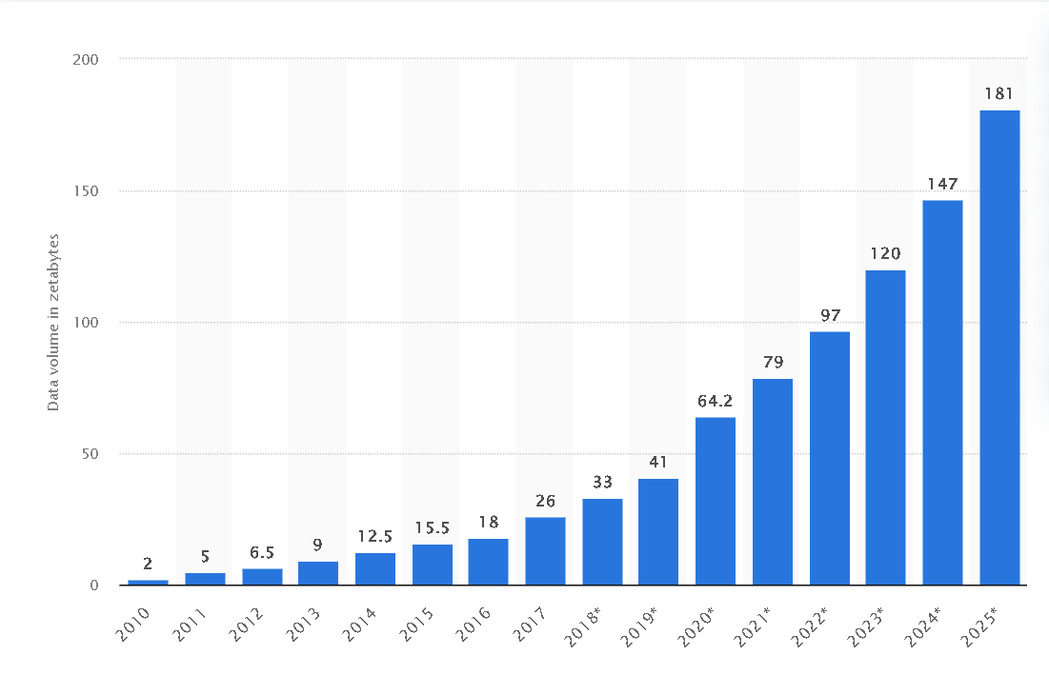
Volume of data/information created, captured, copied, and consumed worldwide from 2010 to 2025
Notes:
trillion Gigabytes is Zetabytes

Slide 7
Three key dimensions of Big Data
Volume: The sheer scale of data generated daily is staggering. Terabytes, petabytes, and even exabytes of information are collected from various sources, including sensors, social media, and transactions.
Velocity: The speed at which data is generated and needs to be processed is a defining characteristic of big data. Real-time data streams, such as stock market updates and social media posts, require immediate analysis for meaningful insights.
Variety: Data comes in diverse formats, such as structured data (like databases and spreadsheets), semi-structured data (like XML and JSON files), and unstructured data (like text, images, and videos). Handling this variety poses a unique challenge.
Notes:
Veracity (data quality and reliability)
Value (extracting meaningful insights)

Slide 8
Fields that generates data
Social networking sites: social media that carry information, posts, links etc of different peoples from all over world like Facebook twitter etc.
Search engines: there are lots of data from different databases that retrieve from search engines.
Medical history : medical history of patients for various health issues from hospitals
Online shopping: shopping online help to know the preferences of customers on different products.
Stock exchange: shares of different companies hold by stock
Power Grid Data: This is data from power grids. It holds information on particular nodes, such as usage information.
Transport Data: This includes possible capacity, vehicle model, availability, and distance covered by a vehicle.
Black Box Data: This is the data generated by airplanes, including jets and helicopters. Black box data includes flight crew voices, microphone recordings, and aircraft performance information.
Notes:
Data.gov (USA)
Data.gov.uk
Data.gov.bd

Slide 9
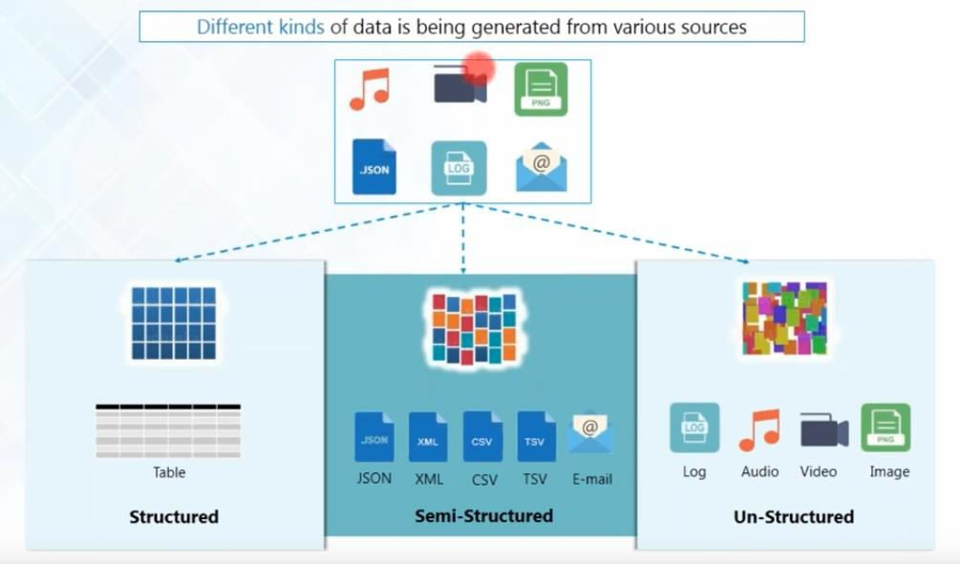

Slide 10
Components of Big Data
Data Sources: These are the origins of big data, including devices, social media platforms, websites, and IoT sensors. They generate raw data that feeds into the analytics process.
Data Collection: It is the process of gathering data from various sources, ensuring its accuracy, and organizing it for analysis. Depending on the application, data may be collected in batch or real-time processes.
Data Storage: Big data storage solutions accommodate the massive volume and variety of data. These solutions include traditional relational databases, NoSQL databases, data lakes, and distributed file systems like Hadoop HDFS.
Data Processing: This component involves transforming raw data into meaningful insights. Technologies like Apache Spark, Hadoop MapReduce, and data processing frameworks enable efficient data analysis and manipulation.
Data Analysis: Big data analytics involves applying various techniques to discover patterns, trends, and correlations within the data. It includes descriptive, diagnostic, predictive, and prescriptive analytics, as well as ML and artificial intelligence.
Data Visualization: Communicating complex insights effectively is crucial. Data visualization tools like Tableau, Power BI, and D3.js help create visually appealing data representations for easier interpretation.

Slide 11
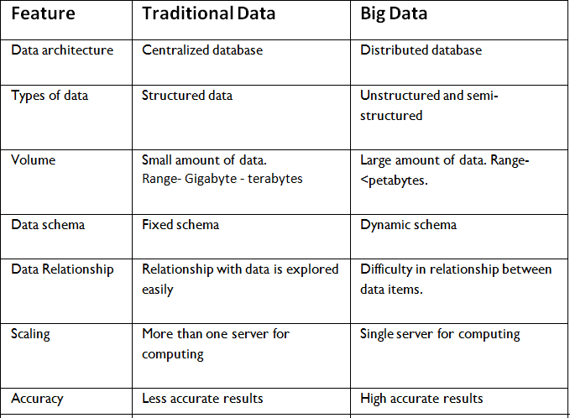
Traditional Data Vs Big Data

Slide 12
Big Data Analytics
Big data analytics is a method to uncover the hidden designs in large data, to extract useful information that can be divided into two major sub-systems: data management and analysis.
Big data analytics is a process of inspecting, differentiating and transforming big data with the goal of identifying useful information, suggesting conclusion and helping to take accurate decisions.
Analytics include both data mining and communication or guide decision making.

Slide 13
The importance of big data analytics
Big data analytics through specialized systems and software can lead to positive business- related outcomes:
New revenue opportunities
More effective marketing
Better customer service
Improved operational efficiency
Competitive advantages over rivals

Slide 14
The importance of big data analytics
Using analytics to understand customer behaviour in order to optimize the customer experience
Predicting future trends in order to make better business decisions
Improving marketing campaigns by understanding what works and what doesn't
Increasing operational efficiency by understanding where bottlenecks are and how to fix them
Detecting fraud and other forms of misuse sooner

Slide 15
Challenges in big data Analytics
Data quality and Veracity issues
Selecting appropriate tools and technologies
Integrating disparate data sources
Ensuring scalability
Managing data governance
Addressing privacy concerns
Notes:
Data governance is everything you do to ensure data is secure, private, accurate, available, and usable. It includes the actions people must take, the processes they must follow, and the technology that supports them throughout the data life cycle.

Slide 16
The Lifecycle Phases of Big Data Analytics
Stage 1 - Business case evaluation - The Big Data analytics lifecycle begins with a business case, which defines the reason and goal behind the analysis.
Stage 2 - Identification of data - Here, a broad variety of data sources are identified.
Stage 3 - Data filtering - All of the identified data from the previous stage is filtered here to remove corrupt data.
Stage 4 - Data extraction - Data that is not compatible with the tool is extracted and then transformed into a compatible form.
Stage 5 - Data aggregation - In this stage, data with the same fields across different datasets are integrated.
Stage 6 - Data analysis - Data is evaluated using analytical and statistical tools to discover useful information.
Stage 7 - Visualization of data - With tools like Tableau, Power BI, and QlikView, Big Data analysts can produce graphic visualizations of the analysis.
Stage 8 - Final analysis result - This is the last step of the Big Data analytics lifecycle, where the final results of the analysis are made available to business stakeholders who will take action.

Slide 17


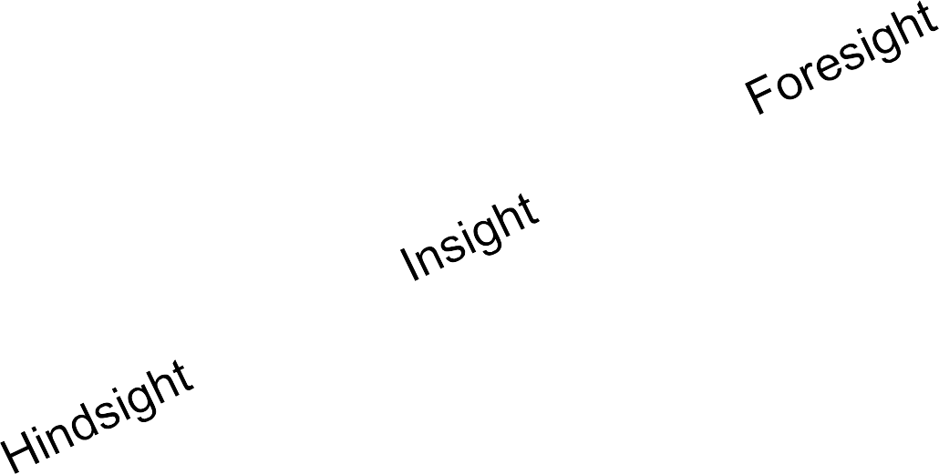


Analytics Models
How can we make it happen?
Prescriptive Analytics
What will happen?
Predictive
Analytics
VALUE
Why did it happen?
What happened?
Descriptive
Analytics
Diagnostic Analytics
DIFFICULTY

Slide 18
Descriptive Analytics
This summarizes past data into a form that people can easily read. This helps in creating reports, like a company’s revenue, profit, sales, and so on. Also, it helps in the tabulation of social media metrics.
Use Case: The Dow Chemical Company analyzed its past data to increase facility utilization across its office and lab space. Using descriptive analytics, Dow was able to identify underutilized space. This space consolidation helped the company save nearly US $4 million annually.

Slide 19
Diagnostic Analytics
This is done to understand what caused a problem in the first place. Techniques like drill-down, data mining, and data recovery are all examples. Organizations use diagnostic analytics because they provide an in-depth insight into a particular problem.
Use Case: An e-commerce company’s report shows that their sales have gone down, although customers are adding products to their carts. This can be due to various reasons like the form didn’t load correctly, the shipping fee is too high, or there are not enough payment options available. This is where you can use diagnostic analytics to find the reason.

Slide 20
Predictive Analytics
This type of analytics looks into the historical and present data to make predictions of the future. Predictive analytics uses data mining, AI, and machine learning to analyze current data and make predictions about the future. It works on predicting customer trends, market trends, and so on.
Use Case: PayPal determines what kind of precautions they have to take to protect their clients against fraudulent transactions. Using predictive analytics, the company uses all the historical payment data and user behaviour data and builds an algorithm that predicts fraudulent activities.

Slide 21
Prescriptive Analytics
This type of analytics prescribes the solution to a particular problem. Perspective analytics works with both descriptive and predictive analytics. Most of the time, it relies on AI and machine learning.
Use Case: Prescriptive analytics can be used to maximize an airline’s profit. This type of analytics is used to build an algorithm that will automatically adjust the flight fares based on numerous factors, including customer demand, weather, destination, holiday seasons, and oil prices.

Slide 22
Big Data Analytics Tools
Hadoop - helps in storing and analyzing data
MongoDB - used on datasets that change frequently
Talend - used for data integration and management
Cassandra - a distributed database used to handle chunks of data
Spark - used for real-time processing and analyzing large amounts of data
STORM - an open-source real-time computational system
Kafka - a distributed streaming platform that is used for fault-tolerant storage

Slide 23
How big data analytics works
Once the data is ready, it can be analyzed with the software commonly used for advanced analytics processes. That includes tools for:
data mining, which sift through data sets in search of patterns and relationships;
predictive analytics, which build models to forecast customer behavior and other future developments;
machine learning, which taps algorithms to analyze large data sets; and
deep learning, a more advanced offshoot of machine learning.

Slide 24
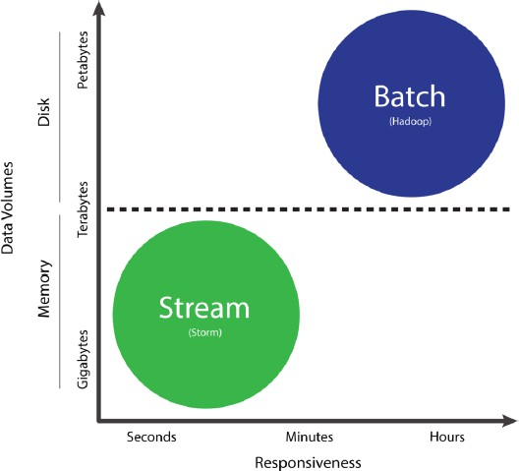
Big Data technologies can be divided into two groups: batch processing, which are analytics on data at rest, and stream processing, which are analytics on data in motion

Slide 25
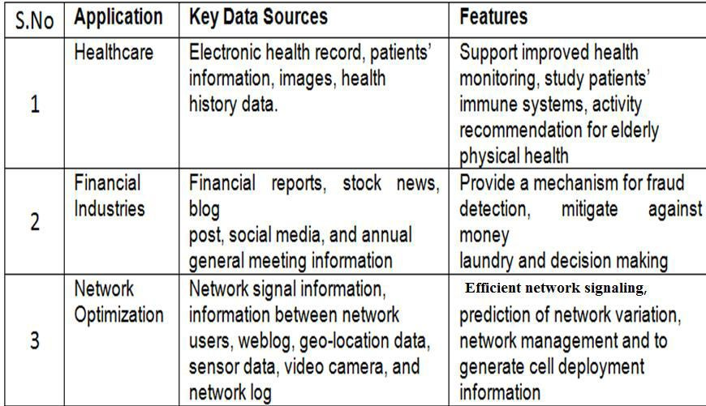
Applications and key data sources for big data and business analytics

Slide 26
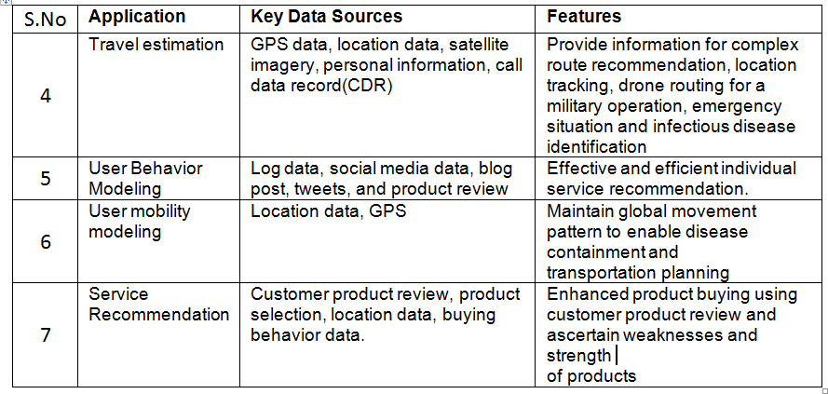

Slide 27
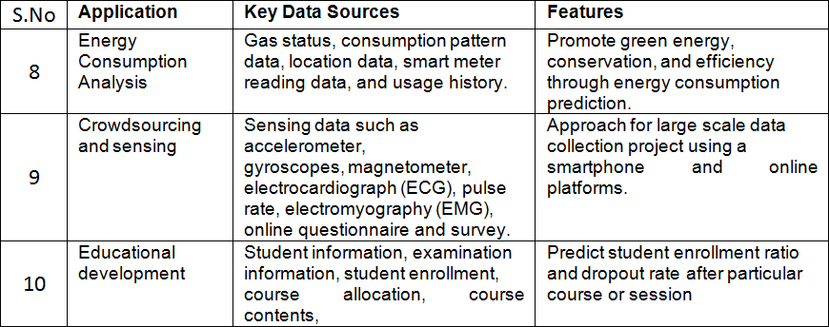

Slide 28
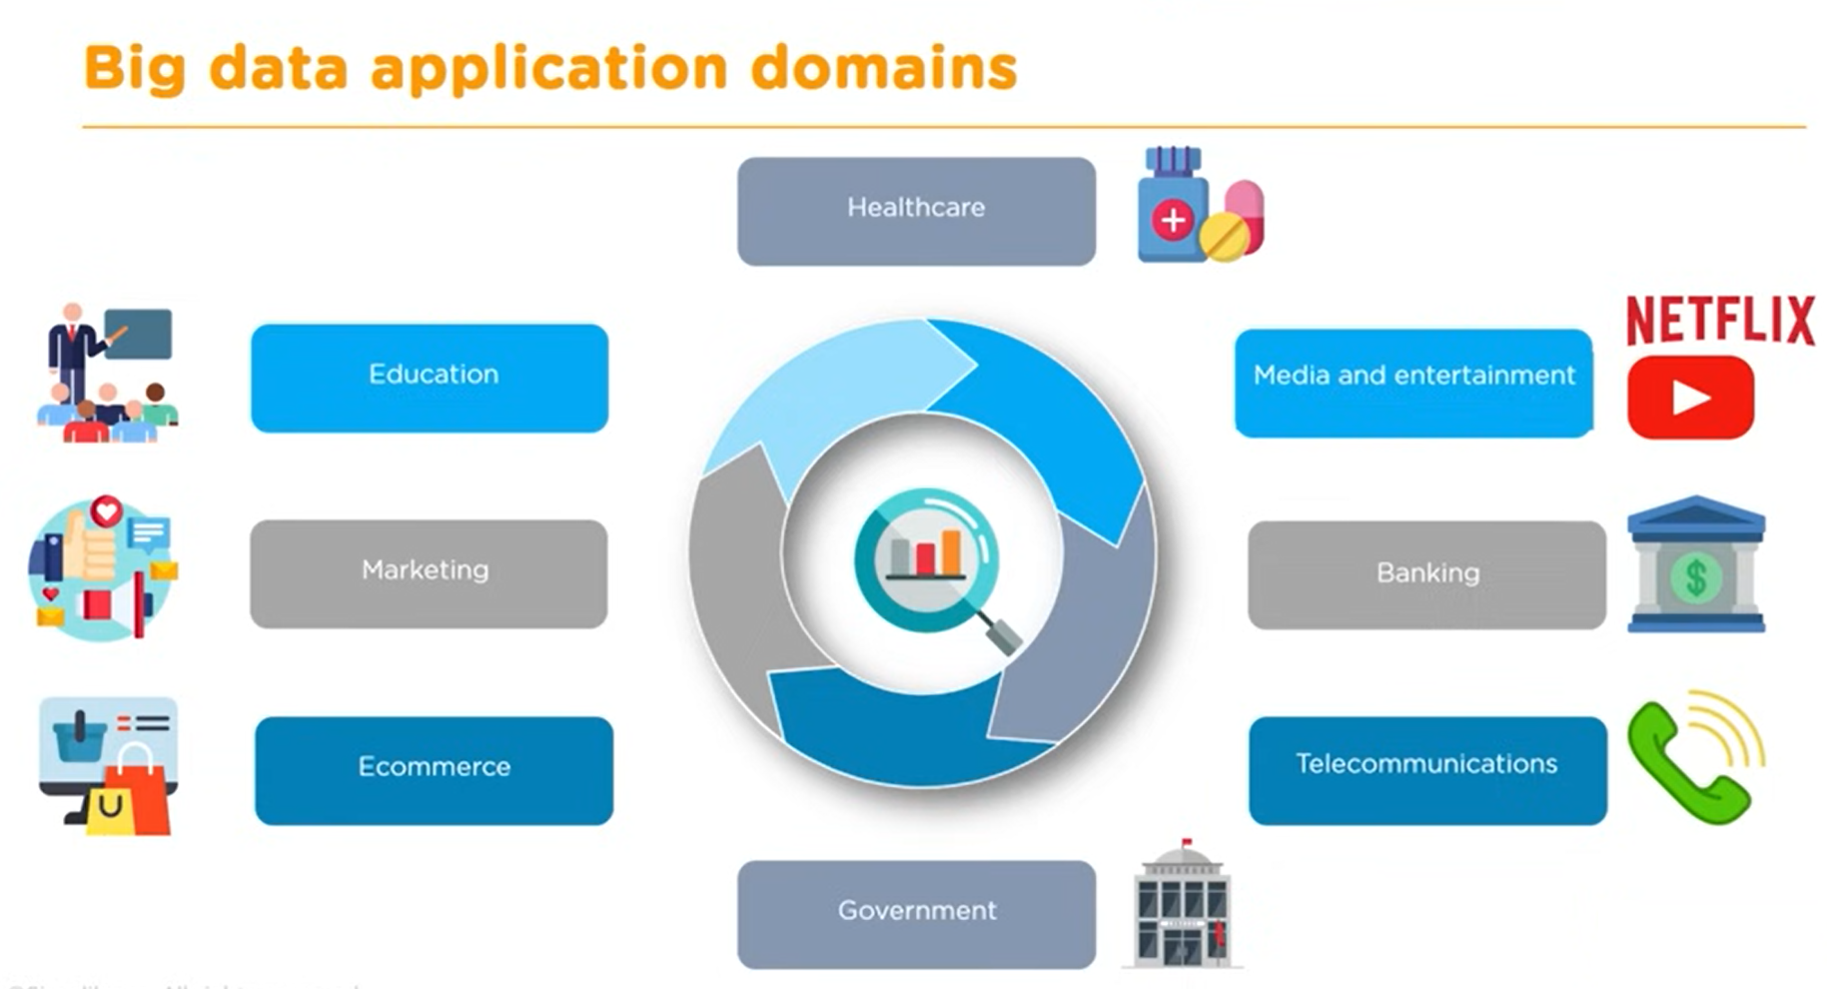

Slide 29
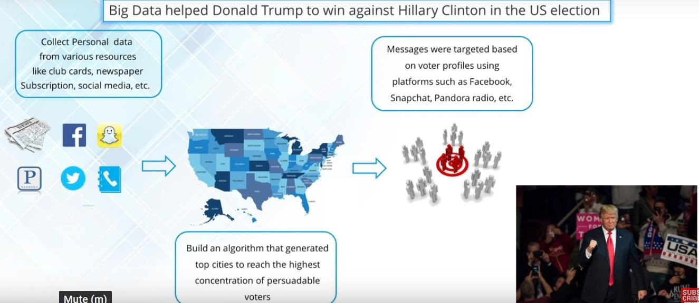
Use cases for Big data analytics

Slide 30
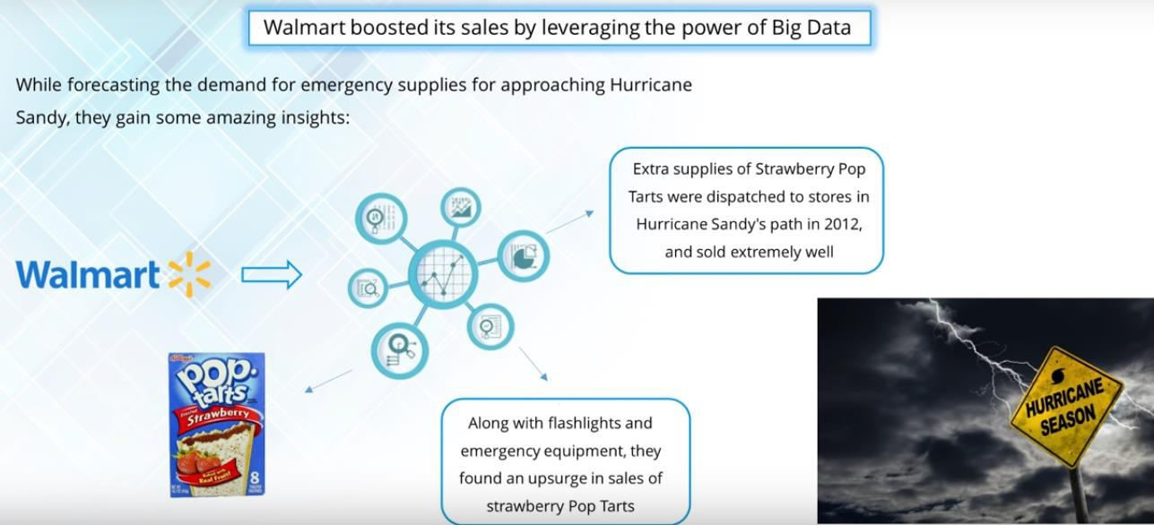

Slide 31
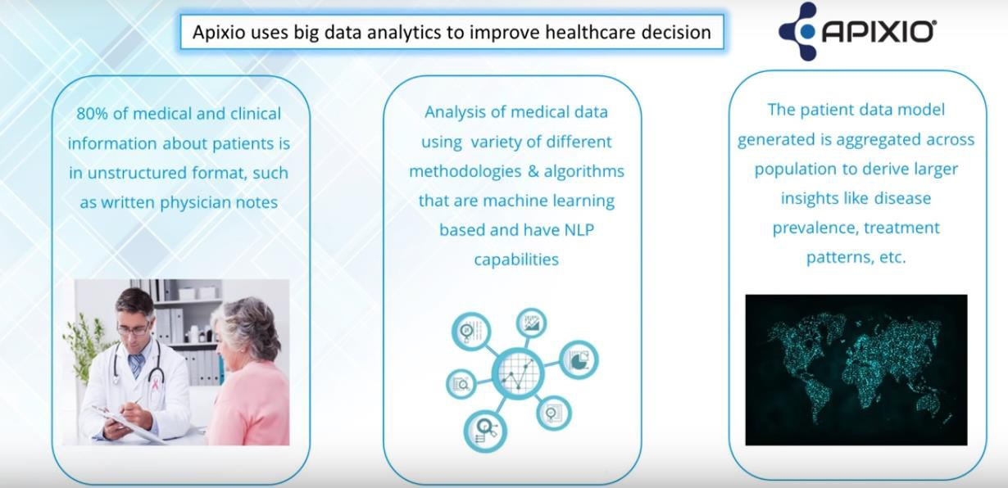

Slide 32
Data warehouse
A data warehouse is an enterprise system used for the analysis and reporting of structured and semi-structured data from multiple sources, such as point-of-sale transactions, marketing automation, customer relationship management, and more. A data warehouse is suited for ad hoc analysis as well custom reporting. A data warehouse can store both current and historical data in one place and is designed to give a long-range view of data over time, making it a primary component of business intelligence.
?

Slide 33
Popular algorithms for data analytics?

Slide 34
Top Big Data Tools?
Apache Spark,
Hadoop MapReduce

Slide 35
Data Visualization Tools Tableau, Power BI, and D3.js

